Slide 1
Understanding
Uloom ul Quran
Syed Aslam

Slide 2


Slide 3
Introduction
It’s a complete code of life
It is a guidance for the entire humanity
The most authentic source of Islamic law
It is the word of Allah
`It’s a revelation from the lord of worlds
It is in the true and genuine form
We have, without doubt, sent down the message; and We will assuredly guard it.” (15:9)
This is an admonition to the people of the whole world”. (81:27)
Quran” means “the most recited”
Before the migration Makki Surahs
After the migration Madani Surahs
90 Makki 24 Madni Surahs

Slide 4
People’s response to the Quran
Quraish used to Make fun of the verses
Put fingers into their ears
Come in the night to listen to the Quran
Prophet (saw) recited Surah Najam and when he reached at the last verse
They taunted when revelation sopped
Some believed that Quran could not be wrong

Slide 5
Characteristics of the Quran
Primary source
The last and the latest book of Allah
Complete code of life
Guidance for entire humanity
The most authentic source of Islamic law
The word of allah
“o mankind if you are in doubt about it come up with a single verse like it”
In the true and genuine form as allah revealed
“We have, without doubt, sent down the message; and we will assuredly guard it.” (15:9)
“This is an admonition to the people of the whole world”. (81:27).
In a living language thus easy to understand till today

Slide 6
Miracles of the Quran
The miracle of 19
The event of Abdullah bin Salam
The event of Surah Jinn

Slide 7
Revelation of the Quran between 610-632
1st revelation in Hira when he was 40
Surah al-Alaq (96.1-5)
“Fatrat-ul-Wahy”–discontinuation of revelation
On this Surah Duha revealed
Total period of 23 years
“Today I have completed the religion and perfected My blesssings upon you,” (Quran)
Arrival of Jibrail (as) was not under his control

Slide 8
Modes of revelation
Appearance of Hazrat Dahya Kalbi (ra)
During sleep while sometimes
When he was all alone and group of companions
The sound of ringing of bells.
Pressure of revelation, Camel would sit on the ground
Zaid felt that his bone would crack
Would move his lips quickly during revelation “don’t move your lips quickly”
Short Surah revealed as a whole, Long surahs revealed in patches
Jibril (as) would tell the proper location
At completion of a Surah, Jibril (as) would inform the name and location of the Surah
The Prophet (saw) would convey to companions.
Preserved on bones, leaves, leather and stones.
Quran was preserved but not compiled

Slide 9
The caliphate of Abu Bakr (ra)
Many Huffaz martyred in battle of Yamama
Umar (ra) suggested compilation
Abu Bakr (ra) was reluctant Later convinced
Zaid bin Sabit (ra) was appointed
“To shift a mountain from one place to another, it would have been an easier task for me rather than to compile the verses of glorious Quran.”
Accepted only if they were contributed by at least two companions in written form
Compared it with the memory of Huffaz
Completed within six months only
Original Quran given to Hazrat Abu Bakr (ra) who handed over it to Hazrat Hafsa (ra)
This Quran is known as Mushaf-e-Hafsa

Slide 10
The caliphate of Usman (ra)
New converts could not recite properly
The hypocrites took undue advantage
Deliberately changed the words of the Quran.
He appointed Hazrat Zaid bin Sabit (ra)
He made the copies of the Quran and distributed
The untrue copies were collected and destroyed.

Slide 11
Qualities needed for Tafseer
Arabic grammar, pronunciation, punctuation
Knowledge of “earab”, Background of verses
Abrogating and abrogated verses e.g. wine
Good character, piety and righteousness

Slide 12
Surah Baqarah 2:284-286
Surah Hujurat 49:1-18
Surah Mominoon 23: 1-11

Slide 13
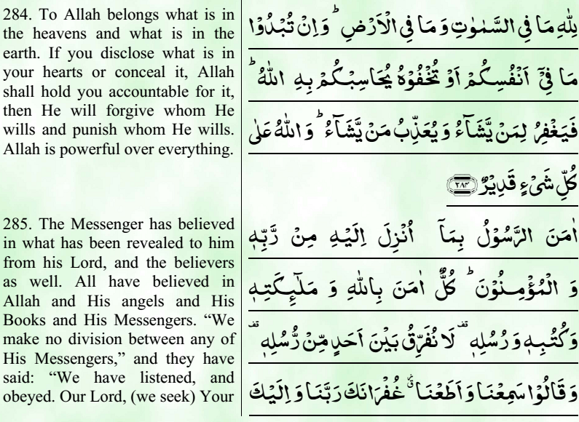
Surah Baqarah Verse 284-286

Slide 14
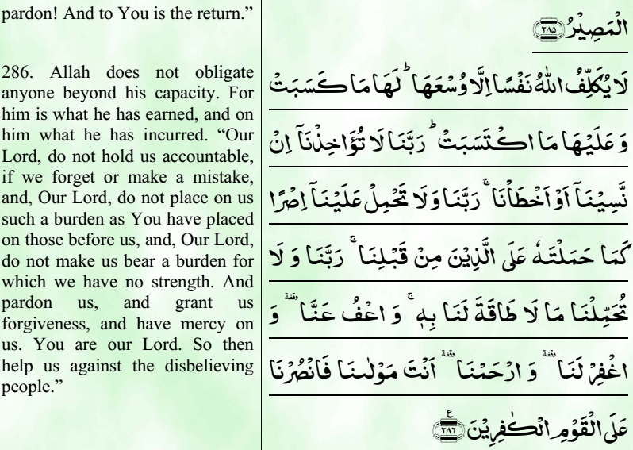
Surah Baqarah Verse 284-286

